Slide 1
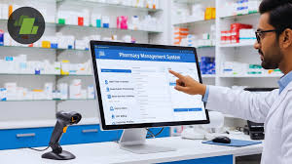
DATABASE MANAGEMENT SYSTEM
Topic:
PHARMACY MANAGEMENT SYSTEM
By:
-SARANSH DUTTA (RA2411003021013)
-NILESH PANDEY (RA2411003021024) -HARSHIT (RA2411003021026)

Slide 2
ABSTRACT
This project implements a Pharmacy Management System using Python and Tkinter, designed to streamline and digitize the daily operations of small and medium-scale pharmacy businesses. The graphical user interface (GUI) provides an intuitive and user-friendly platform for managing pharmacy records efficiently. The system supports the input, storage, updating, and deletion of patient details and prescription data in a structured and organized manner.
By automating record management, the application significantly reduces manual paperwork, minimizes human errors, and improves overall data accuracy. It ensures quick access to patient information, enhances prescription tracking, and simplifies administrative tasks. The system also promotes better data organization and retrieval, enabling pharmacists to manage operations more effectively.
Overall, this Pharmacy Management System offers a reliable, secure, and efficient solution for handling pharmacy records, improving workflow efficiency, and supporting better healthcare service delivery in small pharmacy environments.

Slide 3
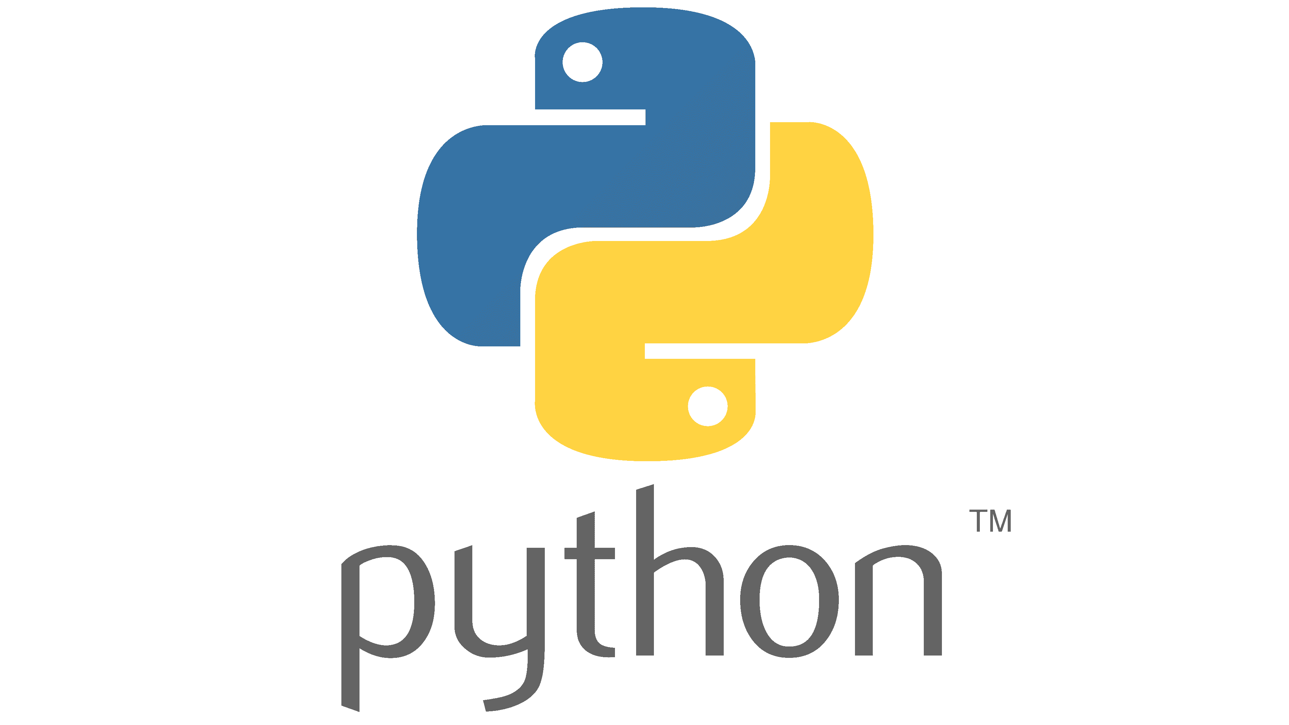

PROBLEM STATEMENT
Problems with Manual Record Keeping
Time-consuming and difficult to maintain
Errors due to handwriting and duplicate entries
Slow data retrieval and reporting
Limited scalability for daily transactions
Proposed Solution: Pharmacy Management System
Digital system to manage patient, prescription, and medicine records
Reduces paperwork and improves accuracy
Fast and organized data storage and retrieval
Technology Stack
Python – Simple, powerful programming language used for backend logic and data handling
Tkinter – Built-in Python GUI library used to create a user-friendly interface
This system provides a cost-effective and efficient solution for small pharmacy operations.

Slide 4
Technology Stack
Python
High-level and easy-to-understand programming language
Used to implement system logic, data handling, and overall functionality
Tkinter
Built-in Python library for creating graphical user interfaces
Used to design forms, buttons, labels, and input fields
Ttk (Treeview)
Advanced Tkinter widget for displaying data in tabular form
Used to show patient, prescription, and medicine records in structured rows and columns
Datetime Module
Python module for handling date and time operations
Used to record prescription dates, billing dates, and transaction timestamps

